Slide 1

Diversity in food culture in select European cities
A. Gutmanas
2 March 2020

Slide 2
The problem
Cities are diverse and offer residents and visitors opportunities to sample world cuisines
But does one need to travel far to find a different cuisine from any neighbourhood?
How much fusion of different traditions can one observe?
Can one quantify the degree to which a city’s culinary culture is mono-, multi-, inter- or transcultural?
A use case in a data-science approach to cultural studies

Slide 3
The cities
I chose four European cities I visited many times: London, Paris, Stockholm and Vilnius.
Metropolitan area (number of boroughs) | Total population (million) | Population density (per sq km) | Residents identifying with non-dominant ethnicity
London (33) | 8.8 | 4,761 | 40 %
Stockholm (26) | 2.2 | 4,800 | 27 %
Paris (12) | 7.2 | 8,598 | 24 %
Vilnius (2) | 0.6 | 1,392 | 37 %

Slide 4
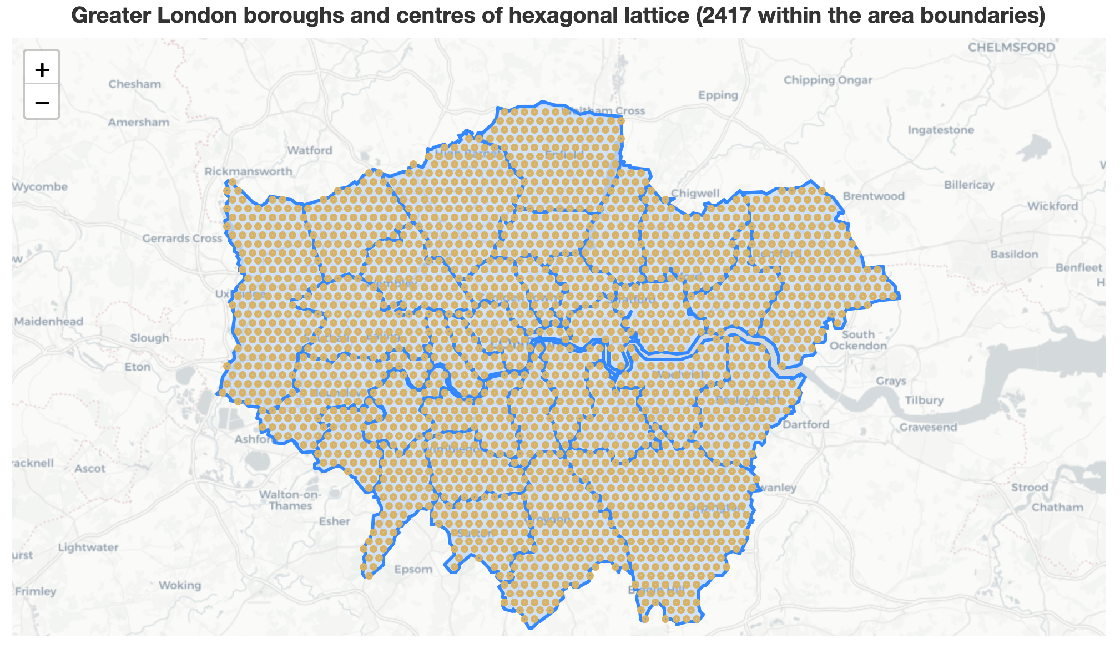
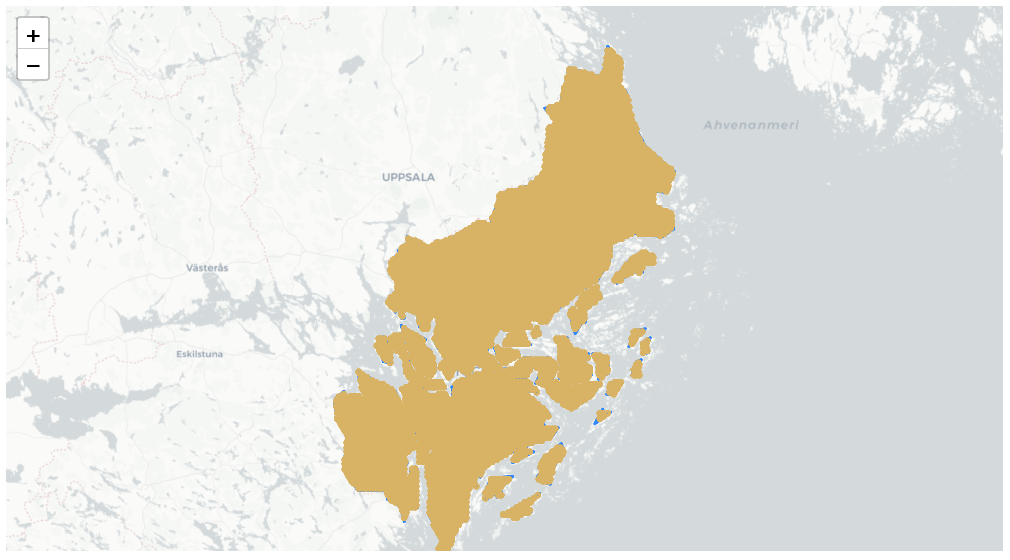
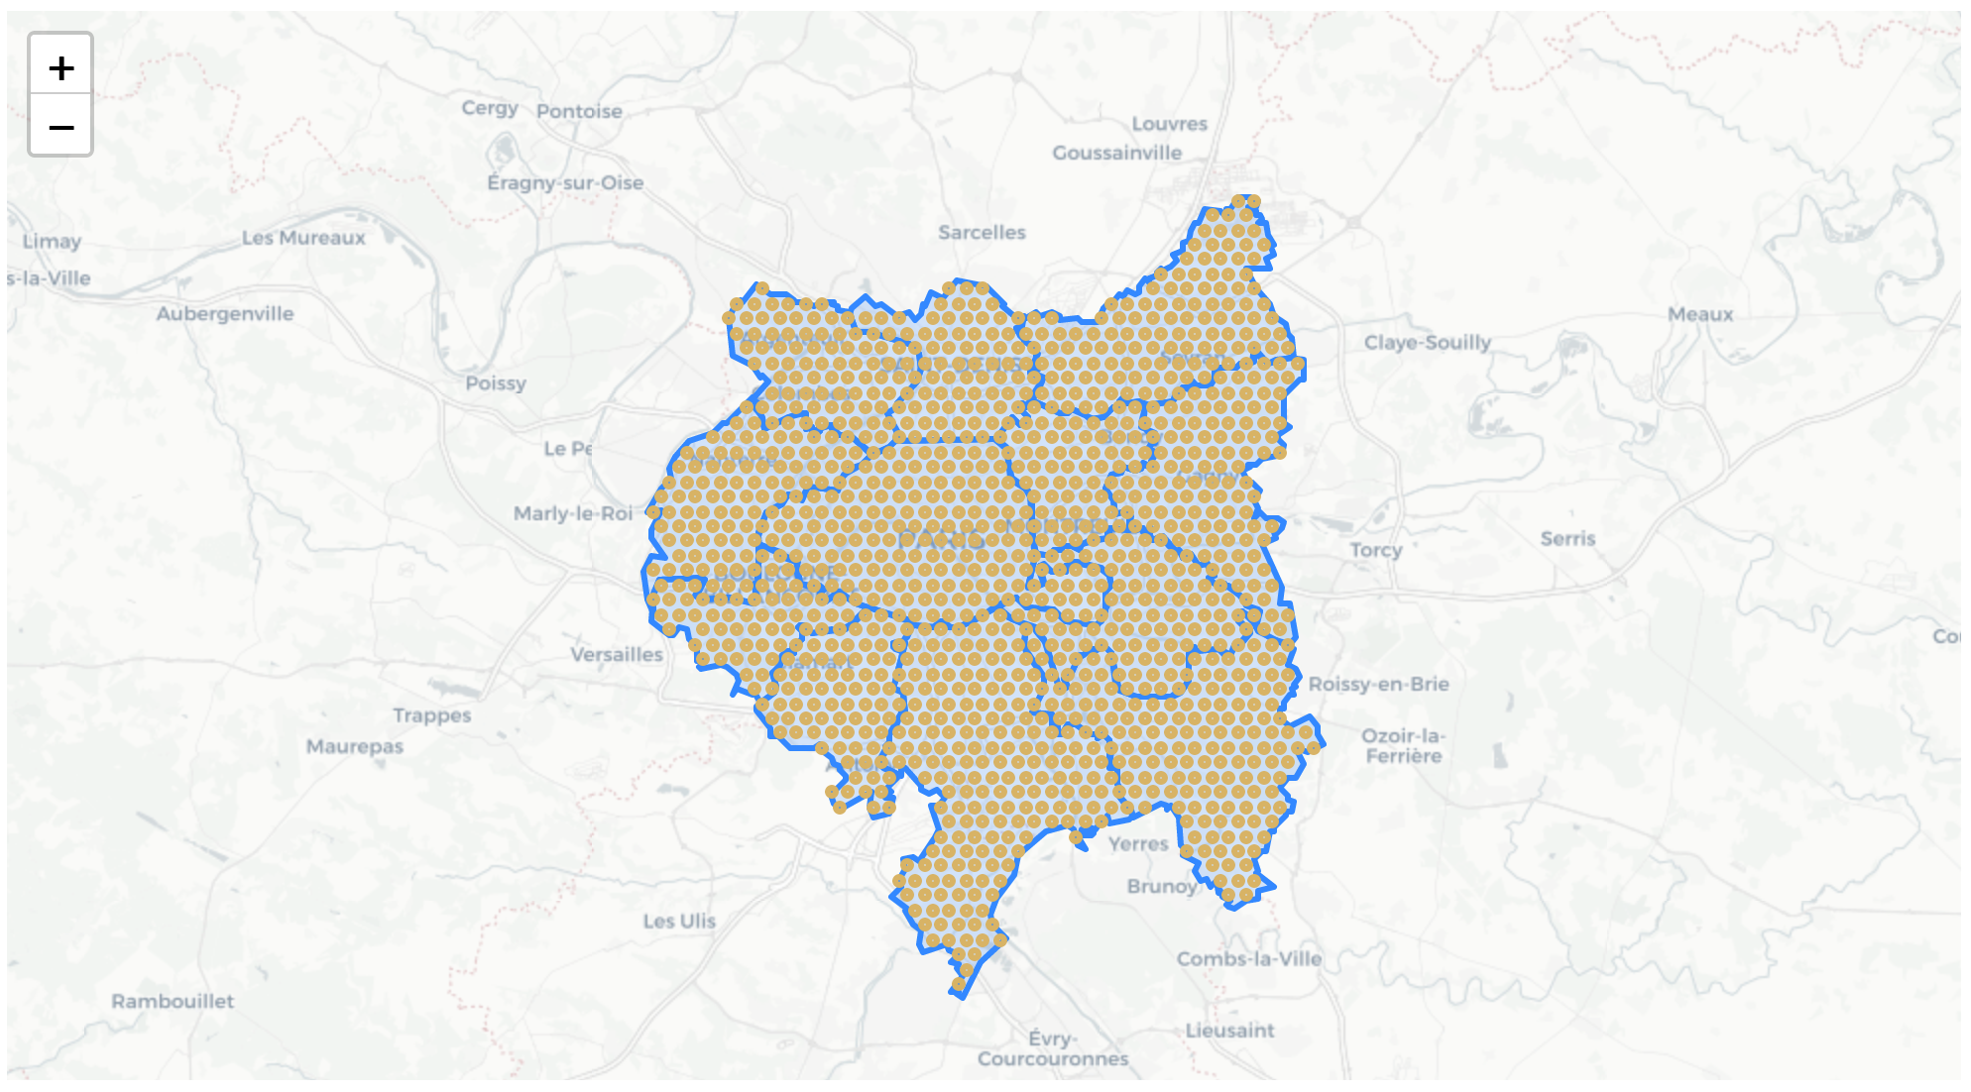
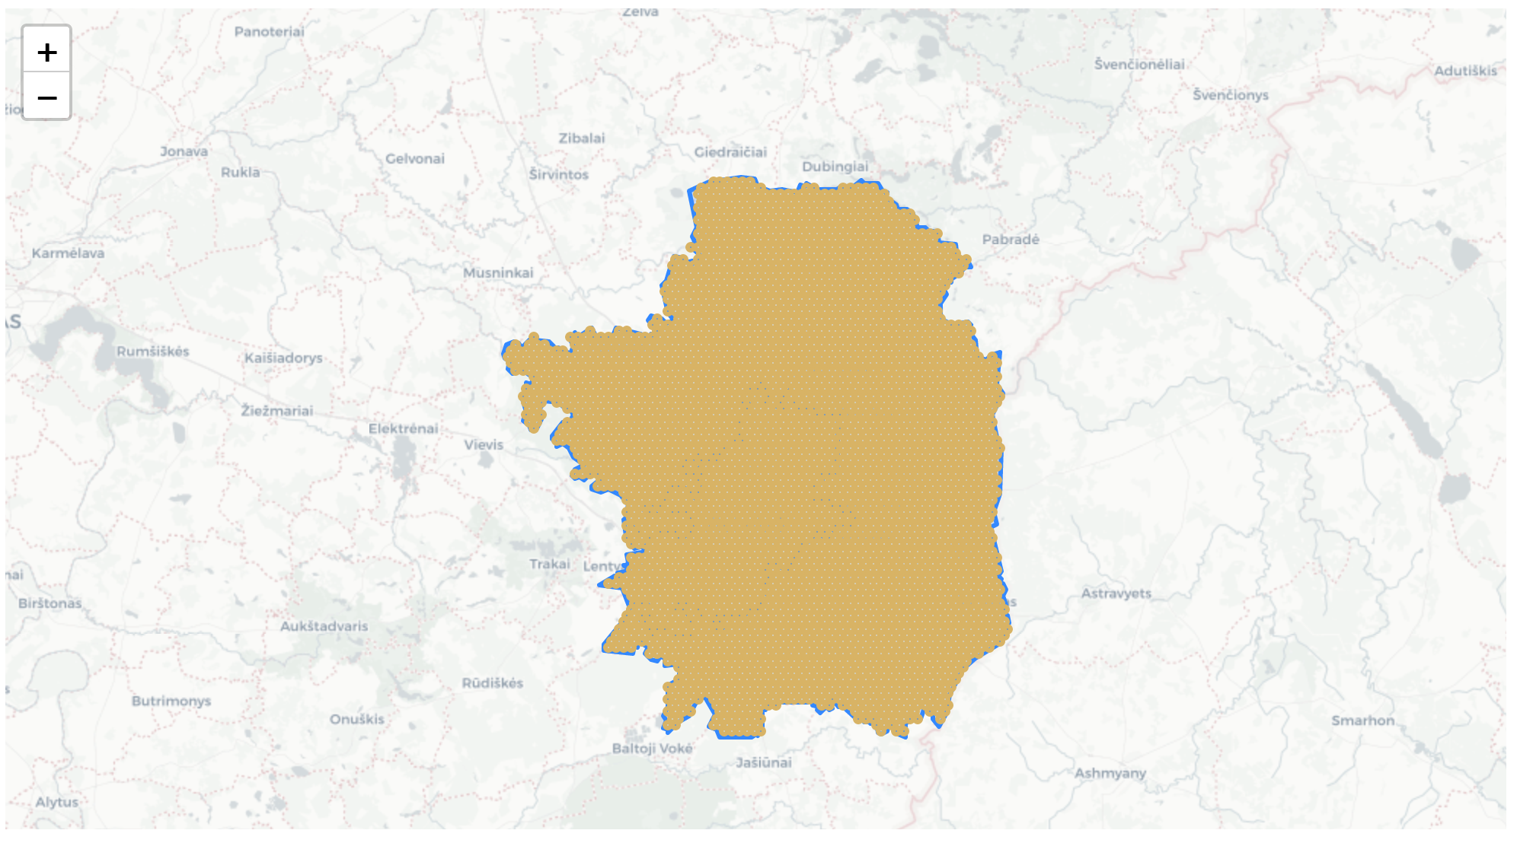
The data - locations
2417
9435
1261
3897
Obtain geoJSONs for the metropolitan areas and cover them in a lattice of hexagons, each inscribed into a circle with radius of 500 m.
London
2417 hexagons
Stockholm
9435 hexagons
Paris
1261 hexagons
Vilnius
3897 hexagons

Slide 5
The data – venue categories
Remapping of the Foursquare API categories to a smaller set of “Cultural” categories, e.g.
Czech Restaurant -> East European
Greek Restaurant -> Mediterranean
Final set of 14 cultural categories

Slide 6
The data - venues
Metropolitan area | Number of culturally categorised venues | Number of hexagons with categorised venues
London | 17,112 | 1,815
Stockholm | 3,751 | 800
Paris | 10,930 | 1,037
Vilnius | 1,036 | 180

Slide 7
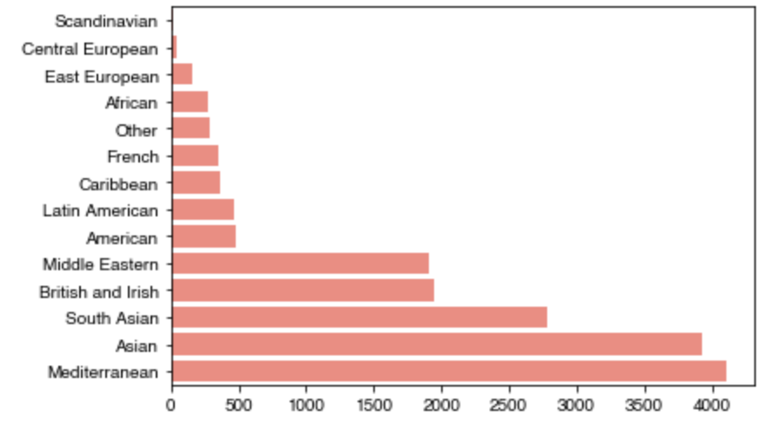
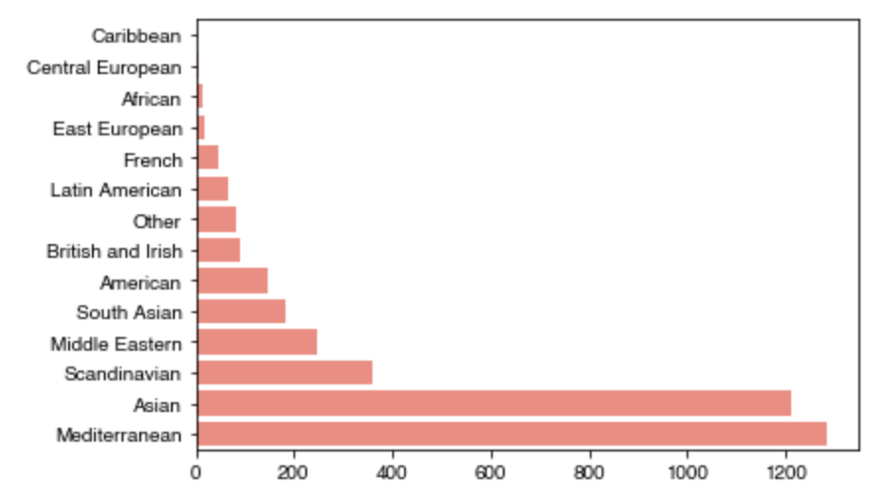
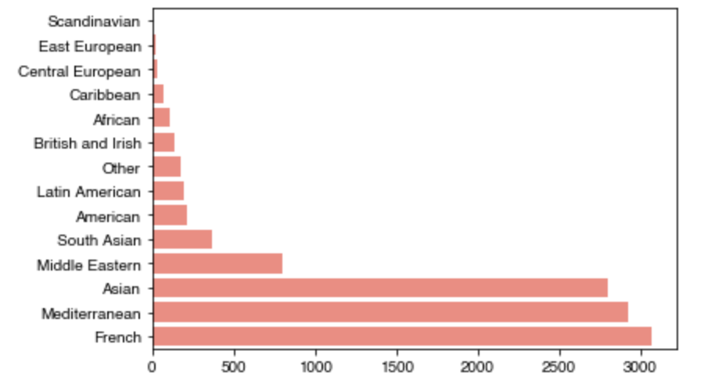
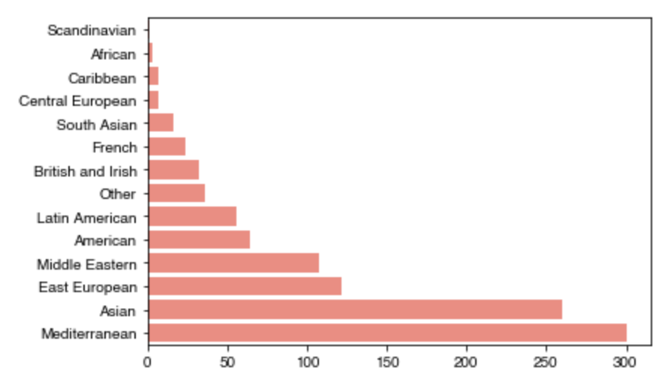
Most popular cuisines: Asian and Mediterranean
London
Stockholm
Paris
Vilnius

Slide 8
K-means clustering
Defined a cultural profile for each area (hexagon) by normalising venue counts (per category) against the total number of venues in the area.
Number of features (cultural categories) between 7 (Stockholm) and 12 (London).
Tested with number of clusters varying between 2 and 24 with 12 replicas in each case.

Slide 9
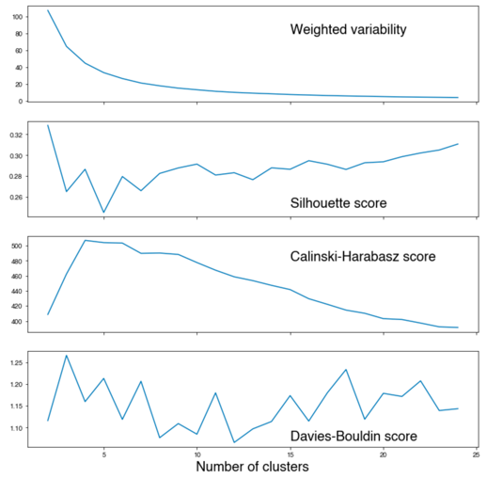
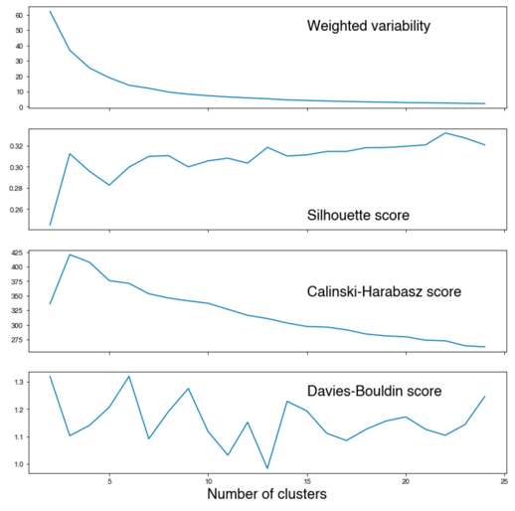
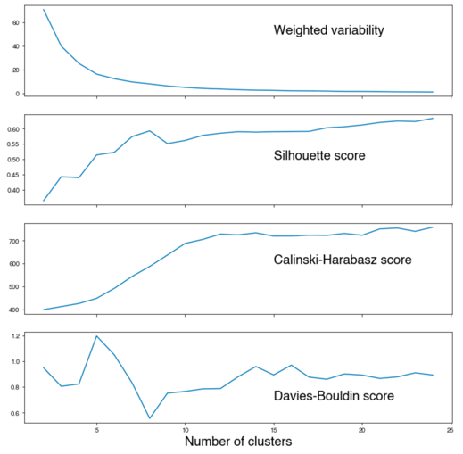
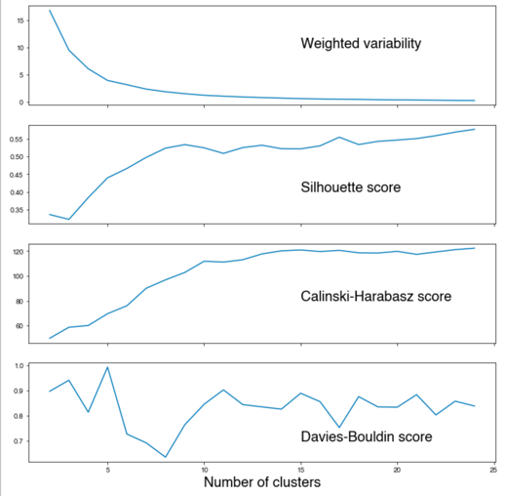
K-means robustness (Calinski-Harabasz score)
London
Paris
Stockholm
Vilnius
Robust clustering with 4-6 clusters for London and 3-4 for Paris
Unclear clustering for Stockholm and Vilnius. Choosing 8 for both, but results not very reliable.

Slide 10
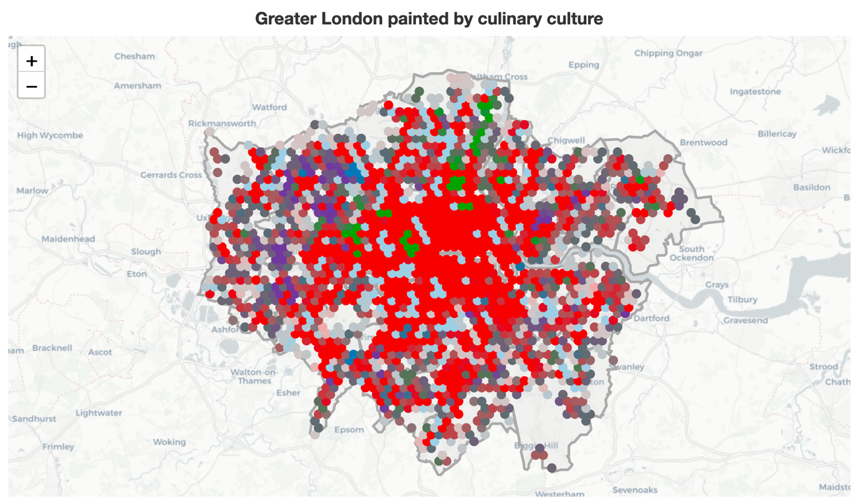
City clusters - London
Mixed cluster (red) dominates
South Asian (purple) cluster in the West
Middle Eastern (green) in the North and West
Mediterranean (pale blue) – spread throughout

Slide 11
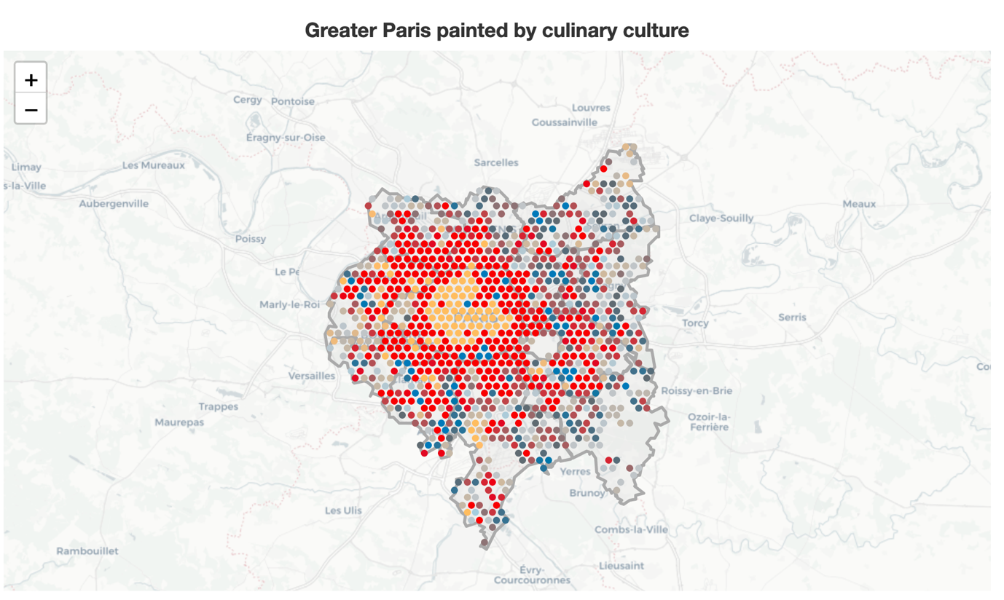
City clusters - Paris
Mixed cluster (red) still the largest, forming a ring around the centre
French (yellow) dominates the centre
Pockets of Asian and French elsewhere

Slide 12
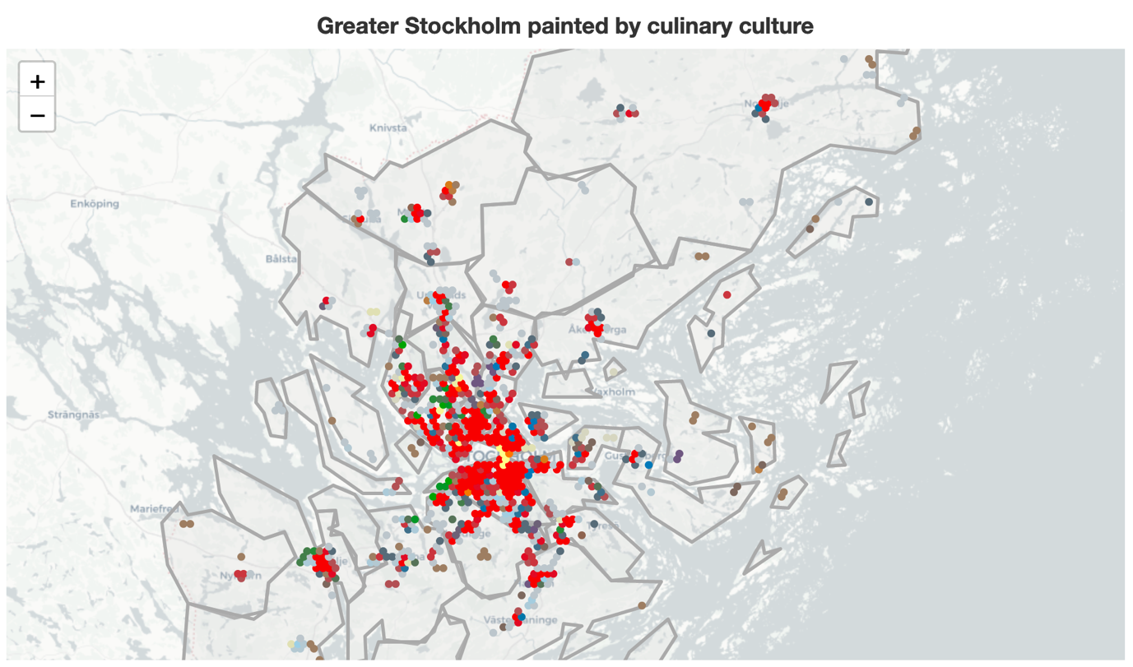
City clusters - Stockholm
Dense core, hardly any data outside it.
Mixed cluster (red) still the largest, dominating the core
Pockets of other cuisines here and there, but no strong pattern

Slide 13
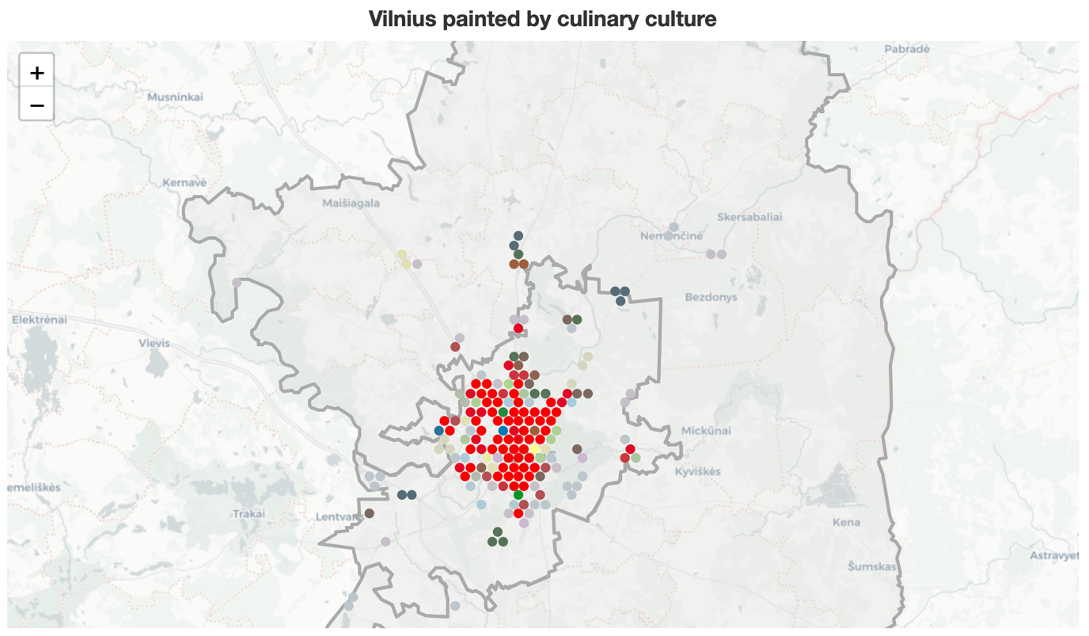
City clusters - Vilnius
Dense core, hardly any data outside it.
Mixed cluster (red) still the largest, dominating the core
Pockets of other cuisines here and there, but no strong pattern

Slide 14
Conclusion
All cities exhibit strong preference for Mediterranean and Asian food.
Paris is unique with its strong core of French cuisine in the centre. Other cities do not show such a strong preference for their “own” cuisine.
London and Paris both show a weak streak of separateness in food culture:
South Asian cluster in the West of London
French cluster in the core of Paris
The mixed cluster is the largest in all 4 cities, but the diversity of the “mix” is greatest in London (only 45% is accounted by Asian and Mediterranean, vs 76% in Stockholm).

